Slide 1
Introduction to the Tree, Application of Tree and Binary Search Tree
Atique Zafar

Slide 2
Quiz2# CLO-2 Marks=5
Write an algorithm in C++ to evaluate a postfix expression using a stack. The algorithm should handle basic arithmetic operations (+, -, *, /) and should be able to evaluate any valid postfix expression.
  (Assume that PUSH and POP function are already built).

Slide 3
Introduction to the Trees

Slide 4
Linear Vs. Non-Linear Data Structure
Linear D.S | Non-Linear D.S
One Path/Street E.g., Stacks, Queues, Linked Lists, etc | divergence in the Road E.g., Trees, graphs, etc

Slide 5
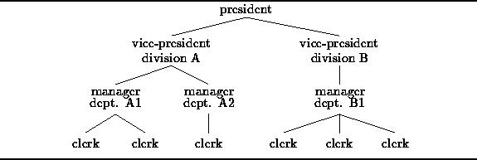
Trees
A tree is often used to represent a hierarchy
Because the relationships between the items in the hierarchy suggest the branches of a botanical tree
For example, a tree-like organization chart is often used to represent the lines of responsibility in a business as shown in Figure

Slide 6
Trees
As we see in the figure, the tree is upside-down
The president is called the root of the tree and the clerks are the leaves
A tree is extremely useful for certain kinds of computations
  For example, suppose we wish to determine the total salaries paid to employees by division or by department
The total of the salaries in division A can be found by computing the sum of the salaries paid in departments A1 and A2 plus the salary of the vice-president of division A

Slide 7
Trees
Similarly, the total of the salaries paid in department A1 is the sum of the salaries of the manager of department A1 and of the two clerks below her.
Clearly, in order to compute all the totals, it is necessary to consider the salary of every employee.
Therefore, an implementation of this computation must visit all the employees in the tree.
An algorithm that systematically visits all the items in a tree is called a tree traversal.

Slide 8
Formal Definitions: Tree
A tree consists of a distinguished node r, called the root, and zero or more (sub) trees T₁, T₂,.……, T_{k}, each of whose roots are connected by a directed edge to r.
The root of each subtree is said to be a child of r and r is the parent of each subtree root.

Slide 9
Formal Definitions: Tree
A tree is a collection of n nodes, one of which is the root, and n -1 edges.
n -1 edges, because each edge connects some node to its parent, and every node except the root has one parent.
Each node may have an arbitrary number of children, possibly zero. Nodes with no children are known as leaves. Nodes with the same parent are siblings.
A Path from node n1 to nk is defined as a sequence of nodes n1, n2, …,nk such that ni is the parent of ni + 1.
The length of this path is the number of edges on the path, namely k – 1.

Slide 10
Formal Definitions: Tree
There is a path of length zero from every node to itself
In a tree there is exactly one path from the root to each node
The level of any node is the length of its path from the root
The degree of a node is its number of subtrees

Slide 11
Tree Terminology
A
Root
-- 0 --
branches
B
C
-- 1 --
D
E
-- 2 --
height : 4
subtree rooted
at F
F
G
-- 3 --
H
I
-- 4 --
: leaves
: internal nodes

Slide 12
Tree Terminology
a path from the root
to a leaf
B is the parent of E
D and E are children of B
F and G are siblings
F is a descendant of B
A is an ancestor of G
D is F’s uncle
A
B
C
D
E
F
G
depth of a node = distance from the root
D has depth 2, H has depth 4
H
I

Slide 13
Binary Tree

Slide 14
Binary Trees
The simplest form of tree is a binary tree. A binary tree consists of
  a node (called the root node) and
  left and right sub-trees
A left or right sub-tree can be empty
Both the sub-trees are themselves binary trees
Each element of the binary tree is called the node of the tree

Slide 15
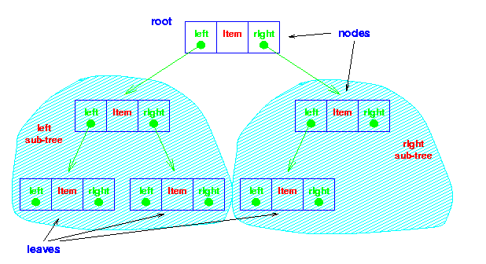
Binary Trees

Slide 16
Binary Trees
Some Binary Trees
One node
Two nodes
Three nodes

Slide 17
Strictly Binary Tree
A strictly binary tree all of whose leaves are at level d
A
/ \
B C
/ \ / \
D E F G
In this example, all the leaves (nodes without children) are at level d=2.
The tree is strictly binary because every node has either 0 or 2 children

Slide 18
Maximum Number of Nodes at Each Level in a Binary Tree
If a binary tree contains m nodes at level l it contains at most 2m nodes at level l+1
A
/ \
B C
/ \ / \
D E F G
/ \ / \
H I J K
If this tree has m=2 nodes at level I=2 (nodes B and C), then at level I+1=3, there can be at most 2m=4 nodes. Here, there are exactly 4 nodes (D, E, F, G).

Slide 19
Complete Binary Tree
A complete binary tree contains 2^{l} nodes at level l
A
/ \
B C
/ \ / \
D E F G
In this complete binary tree, at level l=2, there are 2²=4 nodes (D, E, F, G).

Slide 20
Almost Complete Binary Tree
All levels are complete except for the last level, but the last level is filled from left to right.
A
/ \
B C
/ \ / \
D E F G
/ \
H
Level 1: Node A.
Level 2: Nodes B and C.
Level 3: Nodes D, E, F, and G.
Level 4: Node H.
In this example:
All levels except the last level (Level 4) are complete.
The last level (Level 4) is filled from left to right, with Node H being the leftmost node.

Slide 21
Dynamic Implementation of Binary Tree
Linked Implementation

Slide 22
Binary Trees Traversals

Slide 23
Binary Trees Traversals
Tree Traversal is the process of visiting each node in the tree exactly one time
Tree traversals are of two types
  Depth First Traversal
  Breadth First Traversal

Slide 24
Depth First Traversal
The three Depth First Traversal techniques are
  Preorder tree traversal
  Inorder tree traversal
  Postorder tree traversal

Slide 25
Depth First Traversal
Preorder Tree Traversal
  Visit the root
  Traverse the left sub-tree in preorder
  Traverse the right sub-tree in preorder
A
B
Example:
C
D
E
A
B
C
D
E

Slide 26
Pre-order Traversal:
Root - Left Child - Right Child
A
B
C
D
E
F
G
H
I
J
K
L
M
N
O

Slide 27
Pre-order Traversal:
Root - Left Child - Right Child
A
B
C
D
E
F
G
H
I
J
K
L
M
N
O
A

Slide 28
Pre-order Traversal:
Root - Left Child - Right Child
A
B
C
D
E
F
G
H
I
J
K
L
M
N
O
A

Slide 29
Pre-order Traversal:
Root - Left Child - Right Child
A
B
C
D
E
F
G
H
I
J
K
L
M
N
O
A B

Slide 30
Pre-order Traversal:
Root - Left Child - Right Child
A
B
C
D
E
F
G
H
I
J
K
L
M
N
O
A B

Slide 31
Pre-order Traversal:
Root - Left Child - Right Child
A
B
C
D
E
F
G
H
I
J
K
L
M
N
O
A B D

Slide 32
Pre-order Traversal:
Root - Left Child - Right Child
A
B
C
D
E
F
G
H
I
J
K
L
M
N
O
A B D

Slide 33
Pre-order Traversal:
Root - Left Child - Right Child
A
B
C
D
E
F
G
H
I
J
K
L
M
N
O
A B D H

Slide 34
Pre-order Traversal:
Root - Left Child - Right Child
A
B
C
D
E
F
G
H
I
J
K
L
M
N
O
A B D H

Slide 35
Pre-order Traversal:
Root - Left Child - Right Child
A
B
C
D
E
F
G
H
I
J
K
L
M
N
O
A B D H

Slide 36
Pre-order Traversal:
Root - Left Child - Right Child
A
B
C
D
E
F
G
H
I
J
K
L
M
N
O
A B D H I

Slide 37
Pre-order Traversal:
Root - Left Child - Right Child
A
B
C
D
E
F
G
H
I
J
K
L
M
N
O
A B D H I

Slide 38
Pre-order Traversal:
Root - Left Child - Right Child
A
B
C
D
E
F
G
H
I
J
K
L
M
N
O
A B D H I

Slide 39
Pre-order Traversal:
Root - Left Child - Right Child
A
B
C
D
E
F
G
H
I
J
K
L
M
N
O
A B D H I

Slide 40
Pre-order Traversal:
Root - Left Child - Right Child
A
B
C
D
E
F
G
H
I
J
K
L
M
N
O
A B D H I E

Slide 41
Pre-order Traversal:
Root - Left Child - Right Child
A
B
C
D
E
F
G
H
I
J
K
L
M
N
O
A B D H I E

Slide 42
Pre-order Traversal:
Root - Left Child - Right Child
A
B
C
D
E
F
G
H
I
J
K
L
M
N
O
A B D H I E J

Slide 43
Pre-order Traversal:
Root - Left Child - Right Child
A
B
C
D
E
F
G
H
I
J
K
L
M
N
O
A B D H I E J

Slide 44
Pre-order Traversal:
Root - Left Child - Right Child
A
B
C
D
E
F
G
H
I
J
K
L
M
N
O
A B D H I E J

Slide 45
Pre-order Traversal:
Root - Left Child - Right Child
A
B
C
D
E
F
G
H
I
J
K
L
M
N
O
A B D H I E J K

Slide 46
Pre-order Traversal:
Root - Left Child - Right Child
A
B
C
D
E
F
G
H
I
J
K
L
M
N
O
A B D H I E J K

Slide 47
Pre-order Traversal:
Root - Left Child - Right Child
A
B
C
D
E
F
G
H
I
J
K
L
M
N
O
A B D H I E J K

Slide 48
Pre-order Traversal:
Root - Left Child - Right Child
A
B
C
D
E
F
G
H
I
J
K
L
M
N
O
A B D H I E J K

Slide 49
Pre-order Traversal:
Root - Left Child - Right Child
A
B
C
D
E
F
G
H
I
J
K
L
M
N
O
A B D H I E J K

Slide 50
Pre-order Traversal:
Root - Left Child - Right Child
A
B
C
D
E
F
G
H
I
J
K
L
M
N
O
A B D H I E J K C

Slide 51
Pre-order Traversal:
Root - Left Child - Right Child
A
B
C
D
E
F
G
H
I
J
K
L
M
N
O
A B D H I E J K C

Slide 52
Pre-order Traversal:
Root - Left Child - Right Child
A
B
C
D
E
F
G
H
I
J
K
L
M
N
O
A B D H I E J K C F

Slide 53
Pre-order Traversal:
Root - Left Child - Right Child
A
B
C
D
E
F
G
H
I
J
K
L
M
N
O
A B D H I E J K C F

Slide 54
Pre-order Traversal:
Root - Left Child - Right Child
A
B
C
D
E
F
G
H
I
J
K
L
M
N
O
A B D H I E J K C F L

Slide 55
Pre-order Traversal:
Root - Left Child - Right Child
A
B
C
D
E
F
G
H
I
J
K
L
M
N
O
A B D H I E J K C F L

Slide 56
Pre-order Traversal:
Root - Left Child - Right Child
A
B
C
D
E
F
G
H
I
J
K
L
M
N
O
A B D H I E J K C F L

Slide 57
Pre-order Traversal:
Root - Left Child - Right Child
A
B
C
D
E
F
G
H
I
J
K
L
M
N
O
A B D H I E J K C F L M

Slide 58
Pre-order Traversal:
Root - Left Child - Right Child
A
B
C
D
E
F
G
H
I
J
K
L
M
N
O
A B D H I E J K C F L M

Slide 59
Pre-order Traversal:
Root - Left Child - Right Child
A
B
C
D
E
F
G
H
I
J
K
L
M
N
O
A B D H I E J K C F L M

Slide 60
Pre-order Traversal:
Root - Left Child - Right Child
A
B
C
D
E
F
G
H
I
J
K
L
M
N
O
A B D H I E J K C F L M

Slide 61
Pre-order Traversal:
Root - Left Child - Right Child
A
B
C
D
E
F
G
H
I
J
K
L
M
N
O
A B D H I E J K C F L M G

Slide 62
Pre-order Traversal:
Root - Left Child - Right Child
A
B
C
D
E
F
G
H
I
J
K
L
M
N
O
A B D H I E J K C F L M G

Slide 63
Pre-order Traversal:
Root - Left Child - Right Child
A
B
C
D
E
F
G
H
I
J
K
L
M
N
O
A B D H I E J K C F L M G N

Slide 64
Pre-order Traversal:
Root - Left Child - Right Child
A
B
C
D
E
F
G
H
I
J
K
L
M
N
O
A B D H I E J K C F L M G N

Slide 65
Pre-order Traversal:
Root - Left Child - Right Child
A
B
C
D
E
F
G
H
I
J
K
L
M
N
O
A B D H I E J K C F L M G N

Slide 66
Pre-order Traversal:
Root - Left Child - Right Child
A
B
C
D
E
F
G
H
I
J
K
L
M
N
O
A B D H I E J K C F L M G N O

Slide 67
Pre-order Traversal:
Root - Left Child - Right Child
A
B
C
D
E
F
G
H
I
J
K
L
M
N
O
A B D H I E J K C F L M G N O

Slide 68
Pre-order Traversal:
Root - Left Child - Right Child
A
B
C
D
E
F
G
H
I
J
K
L
M
N
O
A B D H I E J K C F L M G N O

Slide 69
Pre-order Traversal:
Root - Left Child - Right Child
A
B
C
D
E
F
G
H
I
J
K
L
M
N
O
A B D H I E J K C F L M G N O

Slide 70
Pre-order Traversal:
Root - Left Child - Right Child
A
B
C
D
E
F
G
H
I
J
K
L
M
N
O
A B D H I E J K C F L M G N O

Slide 71
Depth First Traversal
Inorder Tree Traversal:
  Traverse the left sub-tree in inorder
  Visit the root
  Traverse the right sub-tree in inorder
A
B
Example:
C
D
E
A
D
C
E
B

Slide 72
In-order Traversal:
Left Child - Root - Right Child
A
B
C
D
E
F
G
H
I
J
K
L
M
N
O

Slide 73
In-order Traversal:
Left Child - Root - Right Child
A
B
C
D
E
F
G
H
I
J
K
L
M
N
O

Slide 74
In-order Traversal:
Left Child - Root - Right Child
A
B
C
D
E
F
G
H
I
J
K
L
M
N
O

Slide 75
In-order Traversal:
Left Child - Root - Right Child
A
B
C
D
E
F
G
H
I
J
K
L
M
N
O
H

Slide 76
In-order Traversal:
Left Child - Root - Right Child
A
B
C
D
E
F
G
H
I
J
K
L
M
N
O
H

Slide 77
In-order Traversal:
Left Child - Root - Right Child
A
B
C
D
E
F
G
H
I
J
K
L
M
N
O
H D

Slide 78
In-order Traversal:
Left Child - Root - Right Child
A
B
C
D
E
F
G
H
I
J
K
L
M
N
O
H D

Slide 79
In-order Traversal:
Left Child - Root - Right Child
A
B
C
D
E
F
G
H
I
J
K
L
M
N
O
H D I

Slide 80
In-order Traversal:
Left Child - Root - Right Child
A
B
C
D
E
F
G
H
I
J
K
L
M
N
O
H D I

Slide 81
In-order Traversal:
Left Child - Root - Right Child
A
B
C
D
E
F
G
H
I
J
K
L
M
N
O
H D I

Slide 82
In-order Traversal:
Left Child - Root - Right Child
A
B
C
D
E
F
G
H
I
J
K
L
M
N
O
H D I B

Slide 83
In-order Traversal:
Left Child - Root - Right Child
A
B
C
D
E
F
G
H
I
J
K
L
M
N
O
H D I B

Slide 84
In-order Traversal:
Left Child - Root - Right Child
A
B
C
D
E
F
G
H
I
J
K
L
M
N
O
H D I B

Slide 85
In-order Traversal:
Left Child - Root - Right Child
A
B
C
D
E
F
G
H
I
J
K
L
M
N
O
H D I B J

Slide 86
In-order Traversal:
Left Child - Root - Right Child
A
B
C
D
E
F
G
H
I
J
K
L
M
N
O
H D I B J

Slide 87
In-order Traversal:
Left Child - Root - Right Child
A
B
C
D
E
F
G
H
I
J
K
L
M
N
O
H D I B J E

Slide 88
In-order Traversal:
Left Child - Root - Right Child
A
B
C
D
E
F
G
H
I
J
K
L
M
N
O
H D I B J E

Slide 89
In-order Traversal:
Left Child - Root - Right Child
A
B
C
D
E
F
G
H
I
J
K
L
M
N
O
H D I B J E K

Slide 90
In-order Traversal:
Left Child - Root - Right Child
A
B
C
D
E
F
G
H
I
J
K
L
M
N
O
H D I B J E K

Slide 91
In-order Traversal:
Left Child - Root - Right Child
A
B
C
D
E
F
G
H
I
J
K
L
M
N
O
H D I B J E K

Slide 92
In-order Traversal:
Left Child - Root - Right Child
A
B
C
D
E
F
G
H
I
J
K
L
M
N
O
H D I B J E K

Slide 93
In-order Traversal:
Left Child - Root - Right Child
A
B
C
D
E
F
G
H
I
J
K
L
M
N
O
H D I B J E K A

Slide 94
In-order Traversal:
Left Child - Root - Right Child
A
B
C
D
E
F
G
H
I
J
K
L
M
N
O
H D I B J E K A

Slide 95
In-order Traversal:
Left Child - Root - Right Child
A
B
C
D
E
F
G
H
I
J
K
L
M
N
O
H D I B J E K A

Slide 96
In-order Traversal:
Left Child - Root - Right Child
A
B
C
D
E
F
G
H
I
J
K
L
M
N
O
H D I B J E K A

Slide 97
In-order Traversal:
Left Child - Root - Right Child
A
B
C
D
E
F
G
H
I
J
K
L
M
N
O
H D I B J E K A L

Slide 98
In-order Traversal:
Left Child - Root - Right Child
A
B
C
D
E
F
G
H
I
J
K
L
M
N
O
H D I B J E K A L

Slide 99
In-order Traversal:
Left Child - Root - Right Child
A
B
C
D
E
F
G
H
I
J
K
L
M
N
O
H D I B J E K A L F

Slide 100
In-order Traversal:
Left Child - Root - Right Child
A
B
C
D
E
F
G
H
I
J
K
L
M
N
O
H D I B J E K A L F

Slide 101
In-order Traversal:
Left Child - Root - Right Child
A
B
C
D
E
F
G
H
I
J
K
L
M
N
O
H D I B J E K A L F M

Slide 102
In-order Traversal:
Left Child - Root - Right Child
A
B
C
D
E
F
G
H
I
J
K
L
M
N
O
H D I B J E K A L F M

Slide 103
In-order Traversal:
Left Child - Root - Right Child
A
B
C
D
E
F
G
H
I
J
K
L
M
N
O
H D I B J E K A L F M

Slide 104
In-order Traversal:
Left Child - Root - Right Child
A
B
C
D
E
F
G
H
I
J
K
L
M
N
O
H D I B J E K A L F M C

Slide 105
In-order Traversal:
Left Child - Root - Right Child
A
B
C
D
E
F
G
H
I
J
K
L
M
N
O
H D I B J E K A L F M C

Slide 106
In-order Traversal:
Left Child - Root - Right Child
A
B
C
D
E
F
G
H
I
J
K
L
M
N
O
H D I B J E K A L F M C

Slide 107
In-order Traversal:
Left Child - Root - Right Child
A
B
C
D
E
F
G
H
I
J
K
L
M
N
O
H D I B J E K A L F M C N

Slide 108
In-order Traversal:
Left Child - Root - Right Child
A
B
C
D
E
F
G
H
I
J
K
L
M
N
O
H D I B J E K A L F M C N

Slide 109
In-order Traversal:
Left Child - Root - Right Child
A
B
C
D
E
F
G
H
I
J
K
L
M
N
O
H D I B J E K A L F M C N G

Slide 110
In-order Traversal:
Left Child - Root - Right Child
A
B
C
D
E
F
G
H
I
J
K
L
M
N
O
H D I B J E K A L F M C N G

Slide 111
In-order Traversal:
Left Child - Root - Right Child
A
B
C
D
E
F
G
H
I
J
K
L
M
N
O
H D I B J E K A L F M C N G O

Slide 112
In-order Traversal:
Left Child - Root - Right Child
A
B
C
D
E
F
G
H
I
J
K
L
M
N
O
H D I B J E K A L F M C N G O

Slide 113
In-order Traversal:
Left Child - Root - Right Child
A
B
C
D
E
F
G
H
I
J
K
L
M
N
O
H D I B J E K A L F M C N G O

Slide 114
In-order Traversal:
Left Child - Root - Right Child
A
B
C
D
E
F
G
H
I
J
K
L
M
N
O
H D I B J E K A L F M C N G O

Slide 115
In-order Traversal:
Left Child - Root - Right Child
A
B
C
D
E
F
G
H
I
J
K
L
M
N
O
H D I B J E K A L F M C N G O

Slide 116
Depth First Traversal
Postorder Tree Traversal:
  Traverse the left sub-tree in postorder
  Traverse the right sub-tree in postorder
  Visit the root
A
B
Example:
C
D
E
D
E
C
B
A

Slide 117
Post-order Traversal:
Left Child - Right Child - Root
A
B
C
D
E
F
G
H
I
J
K
L
M
N
O

Slide 118
Post-order Traversal:
Left Child - Right Child - Root
A
B
C
D
E
F
G
H
I
J
K
L
M
N
O

Slide 119
Post-order Traversal:
Left Child - Right Child - Root
A
B
C
D
E
F
G
H
I
J
K
L
M
N
O

Slide 120
Post-order Traversal:
Left Child - Right Child - Root
A
B
C
D
E
F
G
H
I
J
K
L
M
N
O
H

Slide 121
Post-order Traversal:
Left Child - Right Child - Root
A
B
C
D
E
F
G
H
I
J
K
L
M
N
O
H

Slide 122
Post-order Traversal:
Left Child - Right Child - Root
A
B
C
D
E
F
G
H
I
J
K
L
M
N
O
H

Slide 123
Post-order Traversal:
Left Child - Right Child - Root
A
B
C
D
E
F
G
H
I
J
K
L
M
N
O
H I

Slide 124
Post-order Traversal:
Left Child - Right Child - Root
A
B
C
D
E
F
G
H
I
J
K
L
M
N
O
H I

Slide 125
Post-order Traversal:
Left Child - Right Child - Root
A
B
C
D
E
F
G
H
I
J
K
L
M
N
O
H I D

Slide 126
Post-order Traversal:
Left Child - Right Child - Root
A
B
C
D
E
F
G
H
I
J
K
L
M
N
O
H I D

Slide 127
Post-order Traversal:
Left Child - Right Child - Root
A
B
C
D
E
F
G
H
I
J
K
L
M
N
O
H I D

Slide 128
Post-order Traversal:
Left Child - Right Child - Root
A
B
C
D
E
F
G
H
I
J
K
L
M
N
O
H I D

Slide 129
Post-order Traversal:
Left Child - Right Child - Root
A
B
C
D
E
F
G
H
I
J
K
L
M
N
O
H I D J

Slide 130
Post-order Traversal:
Left Child - Right Child - Root
A
B
C
D
E
F
G
H
I
J
K
L
M
N
O
H I D J

Slide 131
Post-order Traversal:
Left Child - Right Child - Root
A
B
C
D
E
F
G
H
I
J
K
L
M
N
O
H I D J

Slide 132
Post-order Traversal:
Left Child - Right Child - Root
A
B
C
D
E
F
G
H
I
J
K
L
M
N
O
H I D J K

Slide 133
Post-order Traversal:
Left Child - Right Child - Root
A
B
C
D
E
F
G
H
I
J
K
L
M
N
O
H I D J K

Slide 134
Post-order Traversal:
Left Child - Right Child - Root
A
B
C
D
E
F
G
H
I
J
K
L
M
N
O
H I D J K E

Slide 135
Post-order Traversal:
Left Child - Right Child - Root
A
B
C
D
E
F
G
H
I
J
K
L
M
N
O
H I D J K E

Slide 136
Post-order Traversal:
Left Child - Right Child - Root
A
B
C
D
E
F
G
H
I
J
K
L
M
N
O
H I D J K E B

Slide 137
Post-order Traversal:
Left Child - Right Child - Root
A
B
C
D
E
F
G
H
I
J
K
L
M
N
O
H I D J K E B

Slide 138
Post-order Traversal:
Left Child - Right Child - Root
A
B
C
D
E
F
G
H
I
J
K
L
M
N
O
H I D J K E B

Slide 139
Post-order Traversal:
Left Child - Right Child - Root
A
B
C
D
E
F
G
H
I
J
K
L
M
N
O
H I D J K E B

Slide 140
Post-order Traversal:
Left Child - Right Child - Root
A
B
C
D
E
F
G
H
I
J
K
L
M
N
O
H I D J K E B

Slide 141
Post-order Traversal:
Left Child - Right Child - Root
A
B
C
D
E
F
G
H
I
J
K
L
M
N
O
H I D J K E B L

Slide 142
Post-order Traversal:
Left Child - Right Child - Root
A
B
C
D
E
F
G
H
I
J
K
L
M
N
O
H I D J K E B L

Slide 143
Post-order Traversal:
Left Child - Right Child - Root
A
B
C
D
E
F
G
H
I
J
K
L
M
N
O
H I D J K E B L

Slide 144
Post-order Traversal:
Left Child - Right Child - Root
A
B
C
D
E
F
G
H
I
J
K
L
M
N
O
H I D J K E B L M

Slide 145
Post-order Traversal:
Left Child - Right Child - Root
A
B
C
D
E
F
G
H
I
J
K
L
M
N
O
H I D J K E B L M

Slide 146
Post-order Traversal:
Left Child - Right Child - Root
A
B
C
D
E
F
G
H
I
J
K
L
M
N
O
H I D J K E B L M F

Slide 147
Post-order Traversal:
Left Child - Right Child - Root
A
B
C
D
E
F
G
H
I
J
K
L
M
N
O
H I D J K E B L M F

Slide 148
Post-order Traversal:
Left Child - Right Child - Root
A
B
C
D
E
F
G
H
I
J
K
L
M
N
O
H I D J K E B L M F

Slide 149
Post-order Traversal:
Left Child - Right Child - Root
A
B
C
D
E
F
G
H
I
J
K
L
M
N
O
H I D J K E B L M F

Slide 150
Post-order Traversal:
Left Child - Right Child - Root
A
B
C
D
E
F
G
H
I
J
K
L
M
N
O
H I D J K E B L M F N

Slide 151
Post-order Traversal:
Left Child - Right Child - Root
A
B
C
D
E
F
G
H
I
J
K
L
M
N
O
H I D J K E B L M F N

Slide 152
Post-order Traversal:
Left Child - Right Child - Root
A
B
C
D
E
F
G
H
I
J
K
L
M
N
O
H I D J K E B L M F N

Slide 153
Post-order Traversal:
Left Child - Right Child - Root
A
B
C
D
E
F
G
H
I
J
K
L
M
N
O
H I D J K E B L M F N O

Slide 154
Post-order Traversal:
Left Child - Right Child - Root
A
B
C
D
E
F
G
H
I
J
K
L
M
N
O
H I D J K E B L M F N O

Slide 155
Post-order Traversal:
Left Child - Right Child - Root
A
B
C
D
E
F
G
H
I
J
K
L
M
N
O
H I D J K E B L M F N O G

Slide 156
Post-order Traversal:
Left Child - Right Child - Root
A
B
C
D
E
F
G
H
I
J
K
L
M
N
O
H I D J K E B L M F N O G

Slide 157
Post-order Traversal:
Left Child - Right Child - Root
A
B
C
D
E
F
G
H
I
J
K
L
M
N
O
H I D J K E B L M F N O G C

Slide 158
Post-order Traversal:
Left Child - Right Child - Root
A
B
C
D
E
F
G
H
I
J
K
L
M
N
O
H I D J K E B L M F N O G C

Slide 159
Post-order Traversal:
Left Child - Right Child - Root
A
B
C
D
E
F
G
H
I
J
K
L
M
N
O
H I D J K E B L M F N O G C A

Slide 160
Post-order Traversal:
Left Child - Right Child - Root
A
B
C
D
E
F
G
H
I
J
K
L
M
N
O
H I D J K E B L M F N O G C A

Slide 161
Binary Search Trees

Slide 162
BINARY SEARCH TREES
A Binary Search Tree is a type of binary tree, which is either empty or satisfies the following properties :
  Every node has a value and no two nodes have the same value (i.e., all the values are unique).
  If there exists a left child or left sub tree then its value is less than the value of the root.
  The value(s) in the right child or right sub tree is larger than the value of the root node.

Slide 163
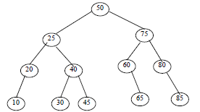
Example
Here the root node information is 50.
Note that the right sub tree node’s value is greater than 50, and the left sub tree nodes value is less than 50.
Again right child node of 25 has large values than 25 and left child node has small values than 25.
Similarly right child node of 75 has large values than 75 and left child node has small values that 75 and so on.

Slide 164
Operation of binary search tree
The operations performed on binary tree can also be applied to Binary Search Tree (BST).
    1. Inserting a node
    2. Searching a node
    3. Deleting a node
Another most commonly performed operation on BST is, traversal.
The tree traversal algorithm (pre-order, post-order and in-order) are the standard way of traversing a binary search tree.

Slide 165
INSERTING A NODE
A BST is constructed by the repeated insertion of new nodes to the tree structure.
Inserting a node in to a tree is achieved by performing two separate operations.
  The tree must be searched to determine where the node is to be inserted.
  Then the node is inserted into the tree.

Slide 166
INSERTING A NODE
1. Input the DATA to be inserted and assign the address of the root node to ROOT.
2. If (ROOT == NULL)
(a) Create a new node with the given DATA and assign its address to ROOT.
(b) Display “Node inserted successfully”
(c) GoTo Step 6
3. If (DATA > ROOT → Info)
(a) If ROOT → RChild == NULL, create a new node with the given DATA and assign its address to ROOT → RChild.
(b) Otherwise, set ROOT = ROOT → RChild and GoTo Step 3.
4. If (DATA < ROOT → Info)
(a) If ROOT → LChild == NULL, create a new node with the given DATA and assign its address to ROOT → LChild.
(b) Otherwise, set ROOT = ROOT → LChild and GoTo Step 4.
5. Display “Node already exists in the tree”
6. Exit

Slide 167
IMPLEMENTATION
#include <iostream>
using namespace std;
// Node structure for BST
struct Node {
int data;
Node* left;
Node* right;
};
// Function to create a new node
Node* createNode(int data) {
Node* newNode = new Node();
newNode->data = data;
newNode->left = newNode->right = NULL;
return newNode;
}

Slide 168
// Function to insert a node into BST
// Iterative insertion
void insertNode(Node*& root, int data) {
Node* newNode = createNode(data);
if (root == nullptr) {
root = newNode;
cout << "Node inserted successfully" << endl;
return;
}
Node* current = root;
Node* parent = nullptr;
while (current != nullptr) {
parent = current;
if (data == current->data) {
cout << "Node already exists in the tree" << endl;
delete newNode; // avoid memory leak
return;
}
else if (data < current->data) {
current = current->left;
}
else {
current = current->right;
}
}
// Attach new node to the correct parent side
if (data < parent->data) {
parent->left = newNode;
} else {
parent->right = newNode;
}
cout << "Node inserted successfully" << endl;
}

Slide 169
Recursive Insertion in BST
#include <iostream>
using namespace std;
// Node structure for BST
struct Node {
int data;
Node* left;
Node* right;
};
// Constructor to initialize a new node
Node(int val) {
data = val;
left = right = nullptr;
}
};

Slide 170
// Function to insert a node into BST
void insertNode(Node*& root, int data) {
if (root == nullptr) {
root = new Node(data);
cout << "Node inserted successfully" << endl;
} else if (data > root->data) {
insertNode(root->right, data); // Go to right subtree
} else if (data < root->data) {
insertNode(root->left, data); // Go to left subtree
} else {
cout << "Node already exists in the tree" << endl; // Handle duplicate
}
}
int main() {
Node* root = nullptr; // Start with an empty tree
insertNode(root, 50);
insertNode(root, 30);
insertNode(root, 70);
insertNode(root, 20);
insertNode(root, 40);
insertNode(root, 60);
insertNode(root, 80);
insertNode(root, 50); // Trying to insert a duplicate value
return 0;
}

Slide 171
Example
Suppose we have a BST like:
50
/
30
You want to insert 20.
Here's how the recursion will flow:
Call 1:
  insertNode(root, 20);
  root = 50
  20 < 50 → Call insertNode(root->left, 20) → Go to Call 2
Call 2:
  root = 30
  20 < 30 → Call insertNode(root->left, 20) → Go to Call 3
Call 3 (Base Case):
  root = nullptr
  Now insert: root = new Node(20);
  Print: Node inserted successfully
  This call now returns
  What Happens When Returning?
  Call 3 returns:
  It inserted the new node and returns control to Call 2
  Call 2 returns:
  Nothing extra happens; it just finishes execution and returns to Call 1
  Call 1 returns:
  Same — just ends and returns to wherever insertNode() was first called.

Slide 172
// Function to display inorder traversal of BST
void inorderTraversal(Node* root) {
if (root == NULL) return;
inorderTraversal(root->left);
cout << root->data << " ";
inorderTraversal(root->right);
}
// Display inorder traversal of BST
cout << "Inorder traversal of BST: ";
inorderTraversal(root);
cout << endl;
return 0;
}
int main() {
Node* root = NULL; // Initialize empty BST
// Insert nodes into BST
insertNode(root, 50);
insertNode(root, 30);
insertNode(root, 20);
insertNode(root, 40);
insertNode(root, 70);
insertNode(root, 60);
insertNode(root, 80);
50
/ \
30 70
/ \ / \
20 40 60 80

Slide 173
SEARCHING A NODE
ALGORITHM
1. Input the DATA to be searched and assign the address of the root node to ROOT.
2. If (DATA == ROOT → Info)
  (a) Display “The DATA exist in the tree”
  (b) GoTo Step 6
3. If (ROOT == NULL)
  (a) Display “The DATA does not exist”
  (b) GoTo Step 6
4. If(DATA > ROOT→Info)
  (a) ROOT = ROOT→RChild
  (b) GoTo Step 2
5. If(DATA < ROOT→Info)
  (a) ROOT = ROOT→Lchild
  (b) GoTo Step 2
6. Exit

Slide 174
BinarySearchTree() : root(nullptr) {}
bool search(int value) {
Node* current = root;
while (current != nullptr) { // Loop until we reach a null node
if (value == current->data) {
return true; // Found the value
} else if (value < current->data) {
current = current->left; // Search left subtree
} else {
current = current->right; // Search right subtree
}
}
return false; // Value not found
}
};
int main() {
// ...(BST creation and usage)
int valueToSearch = 42; // Example value to search for
if (bst.search(valueToSearch)) {
cout << valueToSearch << " found in the BST" << endl;
} else {
cout << valueToSearch << " not found in the BST" << endl;
}
}

Slide 175
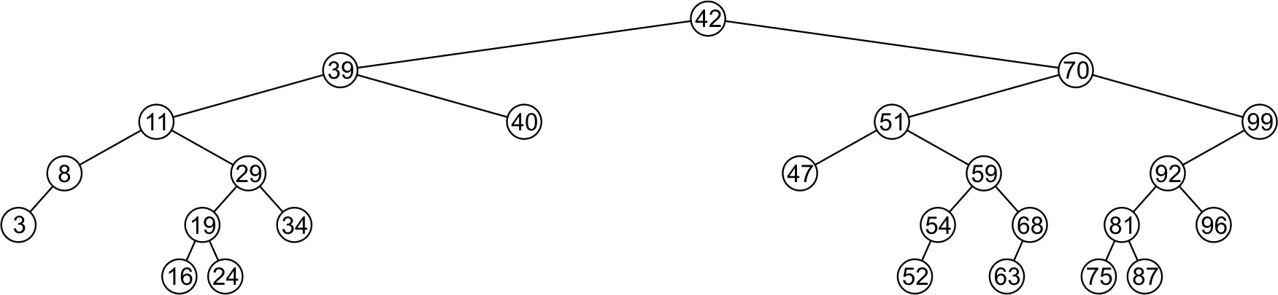
Deleting a Node
A node being erased is not always going to be a leaf node
There are three possible scenarios:
  The node is a leaf node,
  It has exactly one child, or
  It has two children (it is a full node)

Slide 176
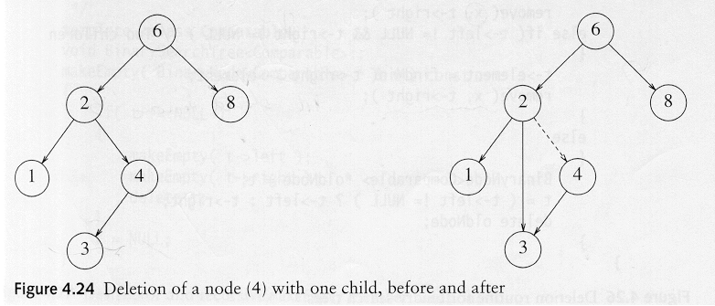
Deletion in BST
Three cases:
(1) The node is a leaf
  Delete it immediately
(2) The node has one child
  Adjust a pointer from the parent to bypass that node

Slide 177
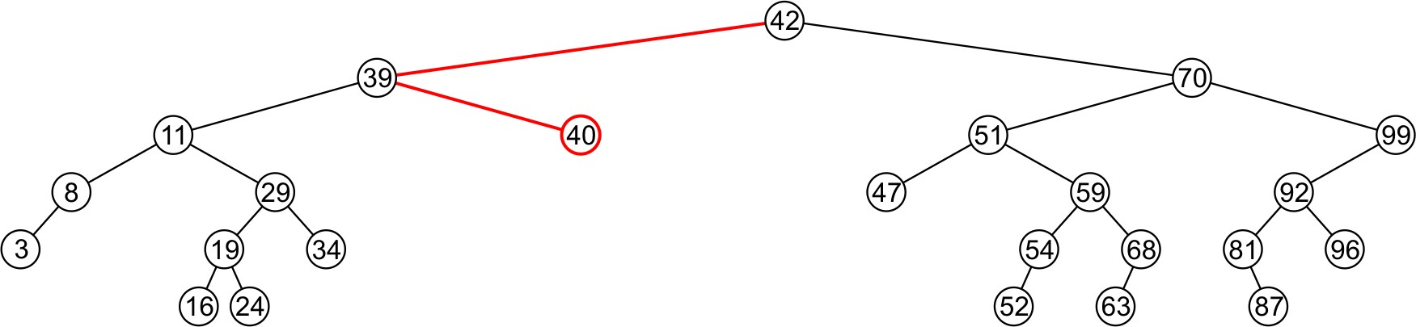
Deleting a Node – Leaf Node
Consider deleting node containing 40

Slide 178
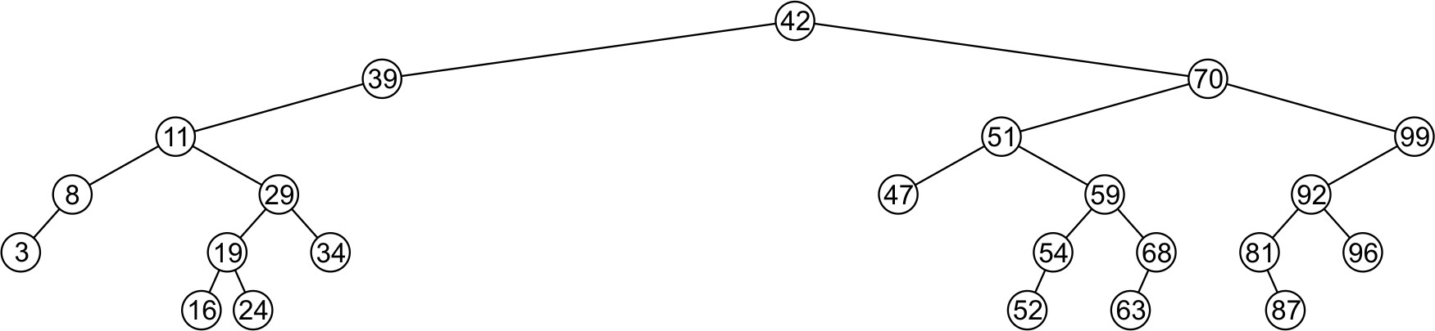
Deleting a Node – Leaf Node
Consider deleting node containing 40
– Node is deleted and right child of 39 is set to NULL

Slide 179
Deleting a Node – Leaf Node
Deleting a leaf node is easy
  Find its parent
  Set the child pointer that links to it to NULL
  Free the node’s memory
Consider deleting node containing 25
10
10 < 25, right
30 > 25, left
25 = 25, delete
10
5
30
5
30
2
25 45
2
45

Slide 180
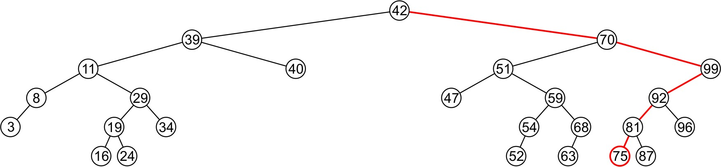
Deleting a Node – Leaf Node
Consider deleting node containing 75

Slide 181
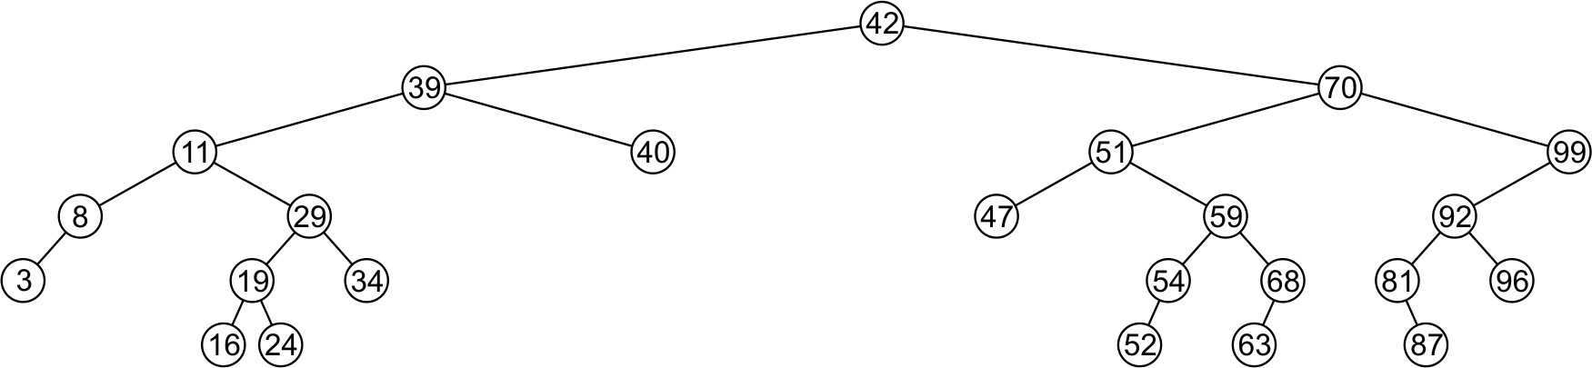
Deleting a Node – Leaf Node
Consider deleting node containing 75
– The node is deleted and left child of 81 is set to NULL

Slide 182
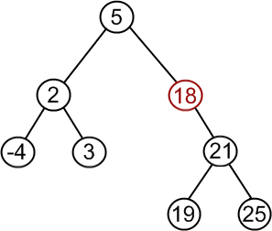
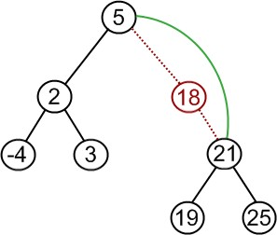
Deleting a Node – Node With Child
If a node has only one child (left or right)
– Simply promote the subtree associated with the child
Consider deleting 18 which has one right child
– Node 18 is deleted and right tree of node 5 is update to point to 21

Slide 183
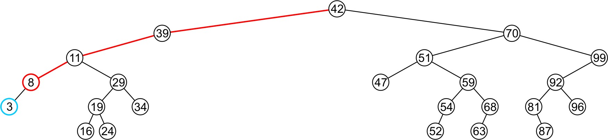
Deleting a Node – Node With Child
Consider deleting 8 which has one left child

Slide 184
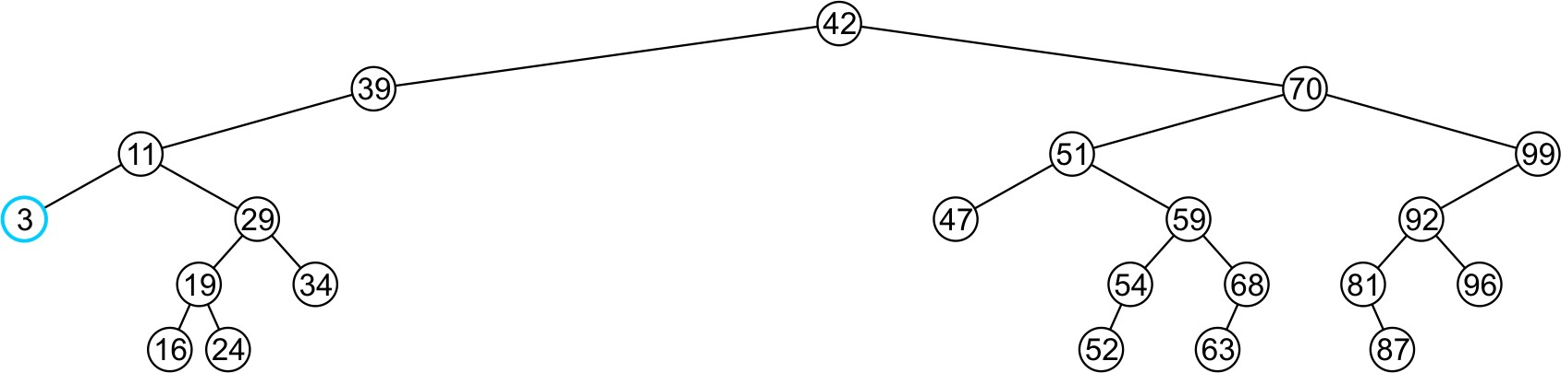
Deleting a Node – Node With Child
Consider deleting 8 which has one left child
– Node 8 is deleted and the left tree of 11 is updated to point to 3

Slide 185
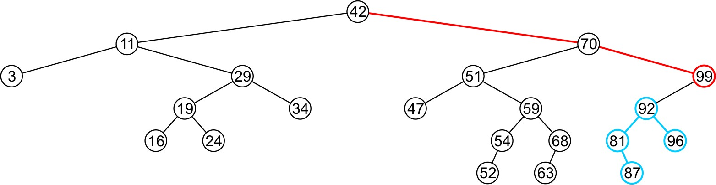
Deleting a Node – Node With Child
Consider deleting the node containing 99

Slide 186
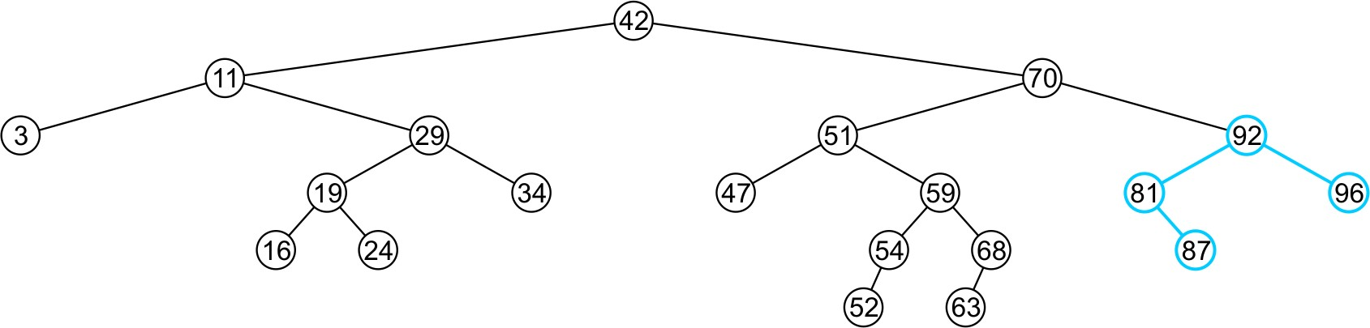
Deleting a Node – Node With Child
Consider deleting the node containing 99
  The right tree of 70 is set to point to node 92
  Again, the order of the tree is maintained

Slide 187
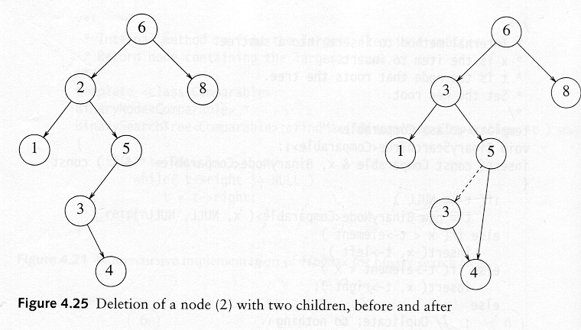
Deletion in BST
(3) The node has 2 children
  Replace the key of that node with the minimum element at the right subtree
  Delete the minimum element
    Has either no child or only right child because if it has a left child, that left child would be smaller and would have been chosen. So invoke case 1 or 2.

Slide 188
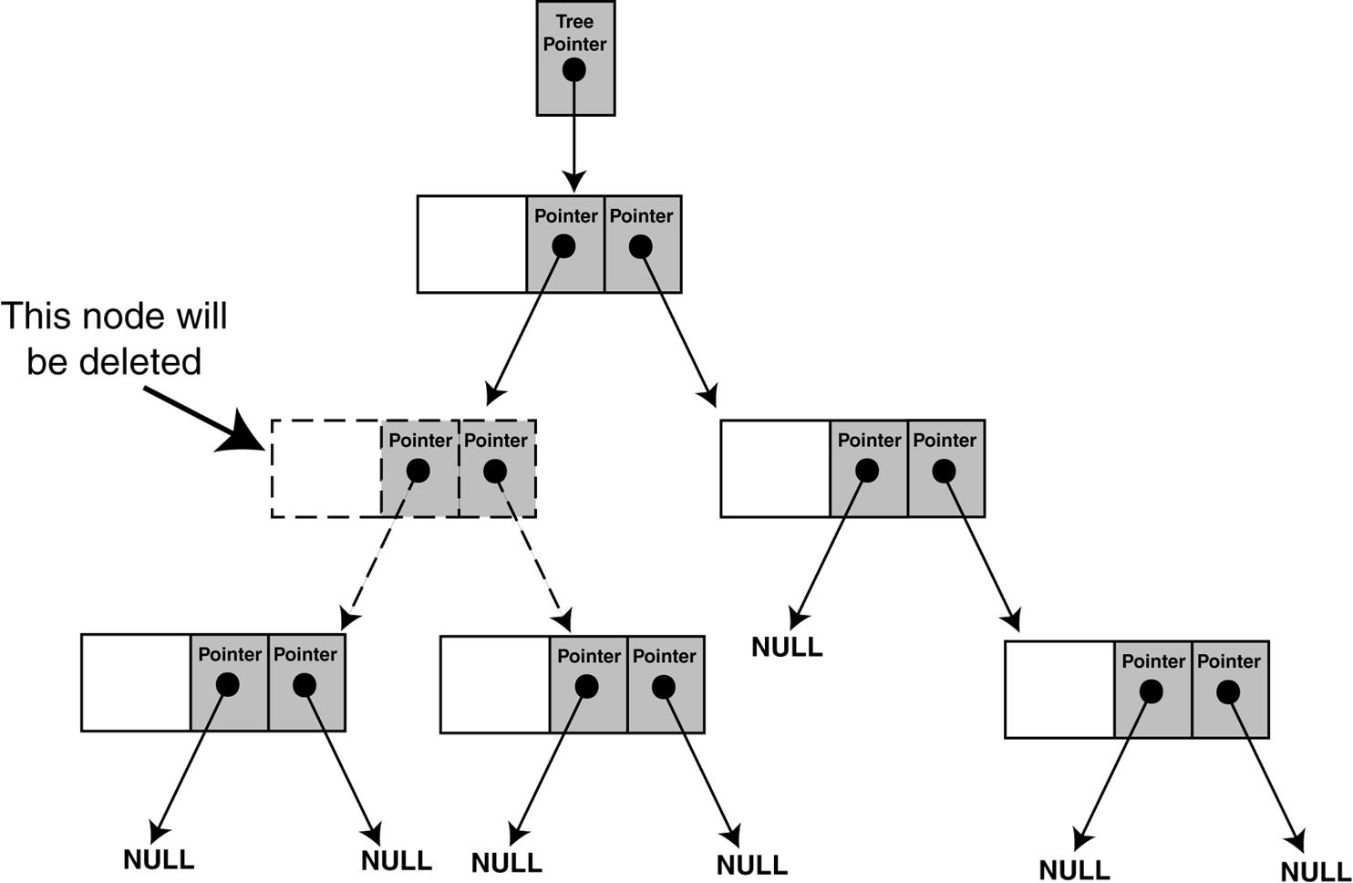
Deleting a Node – Node With Two Children
The problem is not as easily solved if the node has two children

Slide 189
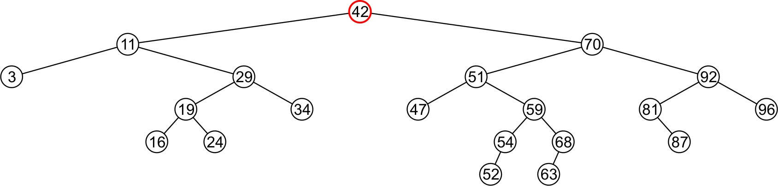
Deleting a Node Two Children – Better Solution
Consider the problem of deleting a full node, e.g., 42

Slide 190
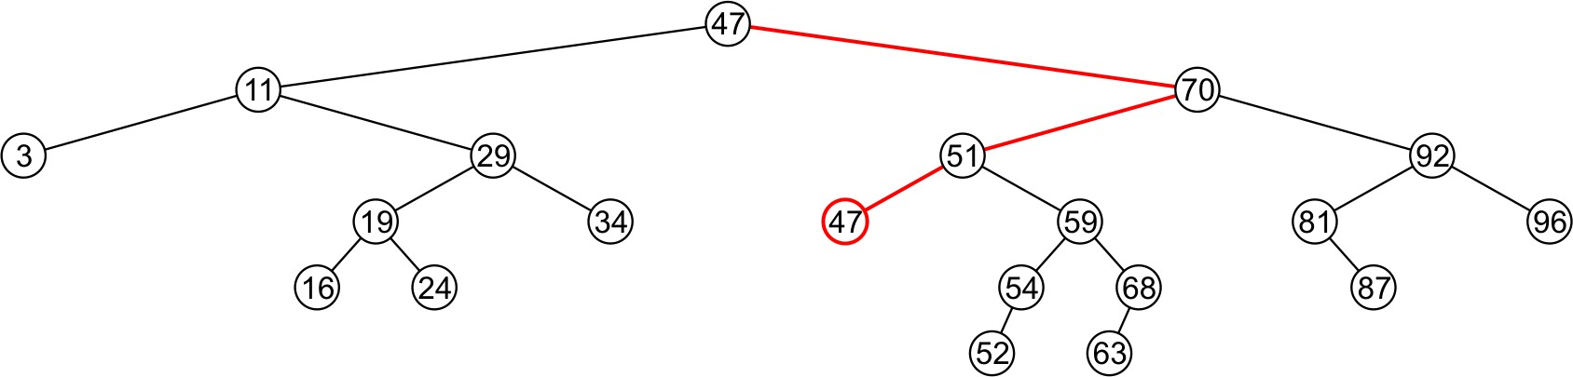
Deleting a Node Two Children – Better Solution
Consider the problem of deleting a full node, e.g., 42
– Find minimum object in the right subtree, i.e., 47

Slide 191
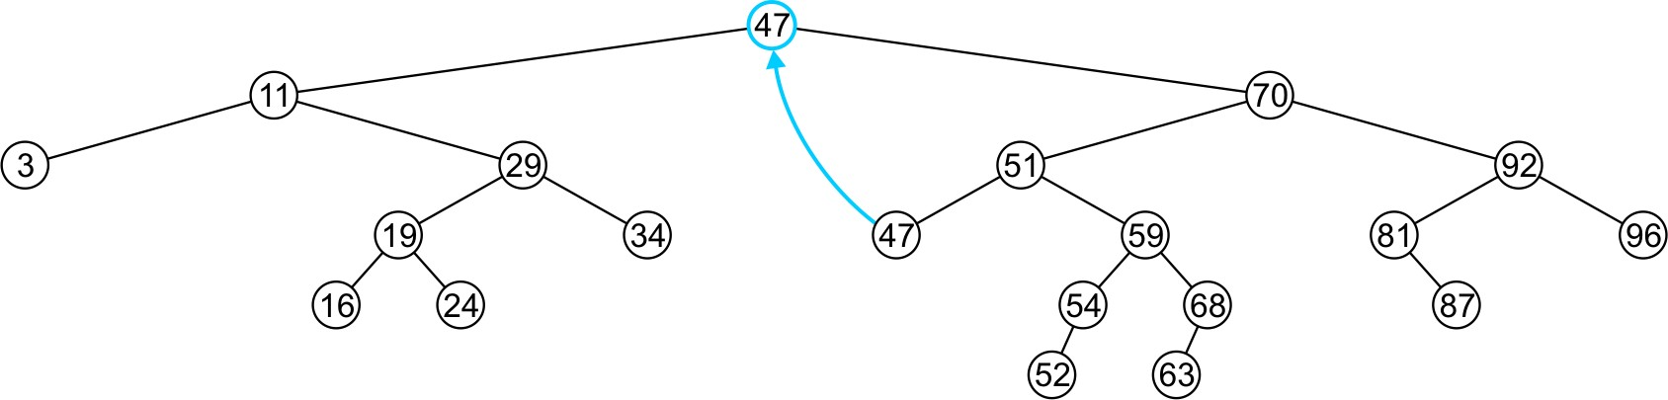
Deleting a Node Two Children – Better Solution
Consider the problem of deleting a full node, e.g., 42
  Find minimum object in the right subtree, i.e., 47
  Replace 42 with 47

Slide 192
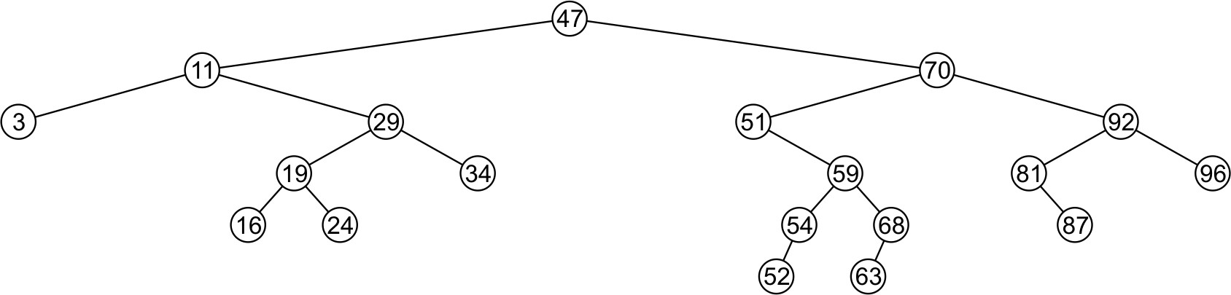
Deleting a Node Two Children – Better Solution
Consider the problem of deleting a full node, e.g., 42
  Find minimum object in the right subtree, i.e., 47
  Replace 42 with 47
  Delete the leaf node 47

Slide 193
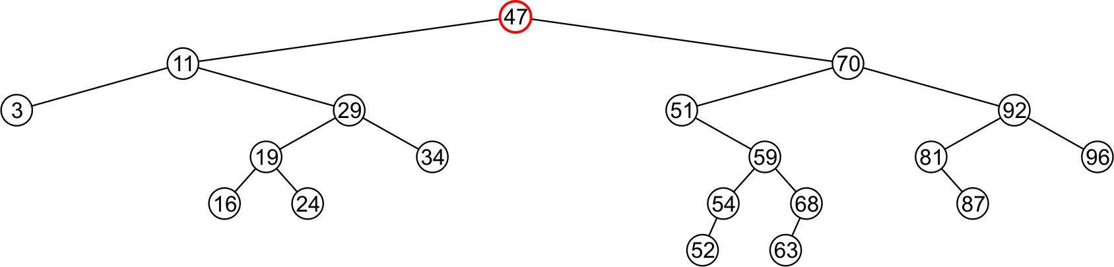
Deleting a Node Two Children – Better Solution
Consider the problem of deleting a full node, e.g., 47

Slide 194
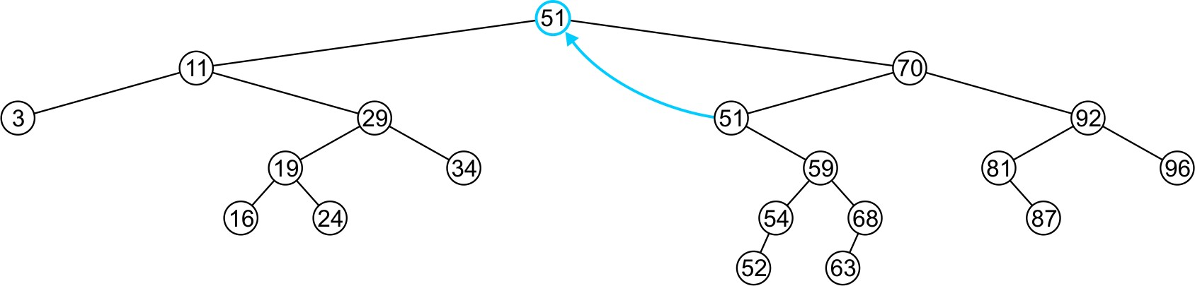
Deleting a Node Two Children – Better Solution
Consider the problem of deleting a full node, e.g., 47
– Replace 47 with 51

Slide 195
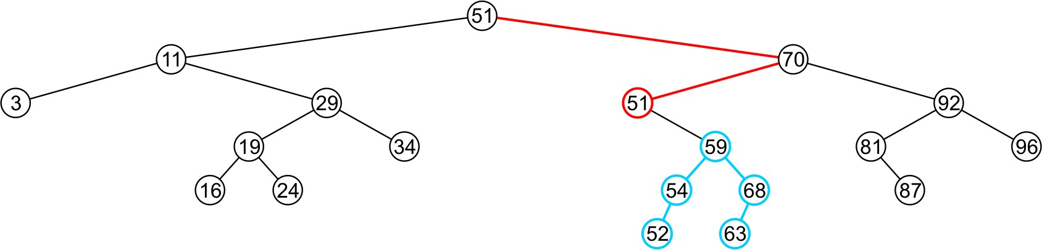
Deleting a Node Two Children – Better Solution
Consider the problem of deleting a full node, e.g., 47
  Replace 47 with 51
  Node 51 is not a leaf node

Slide 196
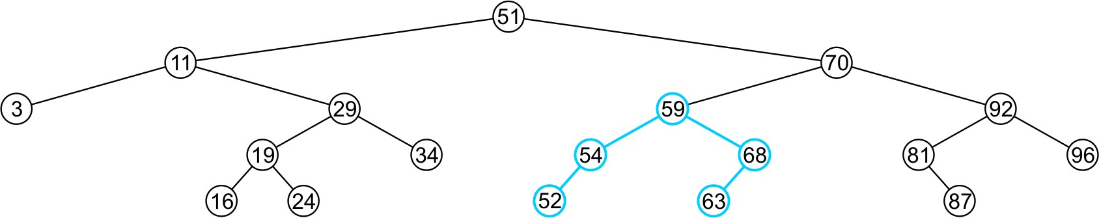
Deleting a Node Two Children – Better Solution
Consider the problem of deleting a full node, e.g., 47
  Replace 47 with 51
  Node 51 is not a leaf node
    Assign the left subtree of 70 to point to 59

Slide 197
Detailed Explanation of the Algorithm
(Base Case)
If the root is nullptr
The function checks if the tree is empty (nullptr).
  If the tree is empty, there's nothing to delete, so it returns nullptr.
  if (root == nullptr) return root;

Slide 198
Detailed Explanation of the Algorithm
(Case 1)
  The data to be deleted is smaller than the root's data
  If the data you're looking to delete is smaller than the current node’s data, you need to go to the left child of the current node.
    if (data < root->data) {
    root->left = delete_node(root->left, data);
    }

Slide 199
Detailed Explanation of the Algorithm
(Case 2)
  The data to be deleted is greater than the root's data
  If the data you're looking to delete is greater than the current node’s data, you need to go to the right child of the current node.
    else if (data > root->data) {
    root->right = delete_node(root->right, data);
    }

Slide 200
Detailed Explanation of the Algorithm
(Case 3)
  The data matches the root’s data (this is the node to delete)
  If you find the node that matches the data, you have three situations to handle, depending on how many children the node has:
    Case 3a: Node has no children (leaf node)
    If the node to delete has no left or right child, you simply remove it by setting the root to nullptr.
    if (root->left == nullptr && root->right == nullptr) {
    root = nullptr; // Delete the node
    }

Slide 201
Detailed Explanation of the Algorithm
(Case 3)
  Case 3b: Node has one child
  If the node to delete has only one child (either left or right), you make the node’s parent point to the child instead of the node, effectively removing the node.
  If the node has only a right child:
  else if (root->left == nullptr) {
  node* temp = root;
  root = root->right; // Move root to the right child
  free(temp); // Free the memory of the old node
  }
  If the node has only a left child:
  else if (root->right == nullptr) {
  node* temp = root;
  root = root->left; // Move root to the left child
  free(temp); // Free the memory of the old node
  }

Slide 202
Detailed Explanation of the Algorithm
(Case 3)
  Case 3c: Node has two children
  If the node to delete has two children (both left and right), the tricky part is replacing it with another node to keep the BST property intact.
  The most common approach is to find the smallest node in the right subtree (also called the in-order successor), copy its value to the node being deleted, and then delete that smallest node from the right subtree.
    Find the smallest node in the right subtree:
  node* temp = root->right;
  while (temp->left != nullptr) {
  temp = temp->left; // Find the leftmost node in the right subtree
  }
    Copy the smallest node’s value to the current node:
    root->data = temp->data; // Replace the data with the smallest value
    Now, delete the smallest node from the right subtree:
    root->right = delete_node(root->right, temp->data);

Slide 203
Deleting Node in BST
struct node
{
int data;
node *left, *right;
};
node* delete_node(node *root, int data)
{
if(root == nullptr) return root;
else
if(data < root->data)
root->left = delete_node(root->left, data);
else
if(data > root->data)
root->right = delete_node(root->right, data);
else
{
if(root->left == nullptr && root->right == nullptr) // Case 1
{
root = nullptr;
}

Slide 204
Deleting Node in BST
else if(root->left == nullptr) //Case 2
{
node* temp = root;
root= root->right;
free(temp);
}
else if(root->right == nullptr) // Case 2
{
node* temp = root;
root = root->left;
free(temp);
}
else // Case 3
{
node* temp = root->right;
while(temp->left != nullptr) temp = temp->left;
root->data = temp->data;
root->right = delete_node(root->right, temp->data);
}
}
return root;
}

Slide 205
Why Binary Search Trees (BST) are Better Than Linear Data Structures
Understanding Time Complexity and Efficiency

Slide 206
The Problem
Imagine you need to find a number in a list of 1 million values.
Two options:
Search from start to end (Linear Search)
Use a smarter method like Binary Search Tree (BST)
Which one sounds faster?

Slide 207
What is a BST?
Binary Tree with the following rule:
  Left Child < Parent
  Right Child > Parent
Example:
50
/ \
30 70
/ \ / \
20 40 60 80
Helps quickly eliminate half of the tree on each comparison

Slide 208
Time Complexity Comparison
Operation | Linear List | BST (Balanced)
-------------- |---------------|----------------
Search | O(n) | O(log n)
Insertion | O(1)/O(n)| O(log n)
Deletion | O(n) | O(log n)
BST is much faster for large datasets (if balanced)

Slide 209
Real-World Analogy
Linear Search: Checking every door in a hotel to find your friend
BST: Asking at the front desk which floor/room they're on, narrowing down quickly

Slide 210
What Happens If BST is Not Balanced?
Example of sorted insertion:
10
\
20
\
30
\
40
Acts like a Linked List
Time Complexity becomes O(n)

Slide 211
How to Keep BST Balanced?
Use Self-Balancing Trees:
- AVL (Adelson-Velsky and Landis) Tree

Slide 212

Balance Factor Concept
balance factor = height(left subtree) - height(right subtree)
valid balance factor values: -1, 0, 1
node becomes unbalanced if balance factor is beyond these values

Slide 213
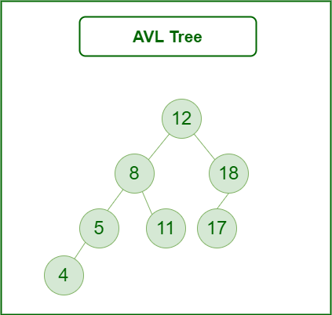
Example of an AVL Tree
Every AVL tree is also a Binary Search Tree (Left subtree values Smaller and Right subtree values greater for every node), but every BST is not AVL Tree.

Slide 214
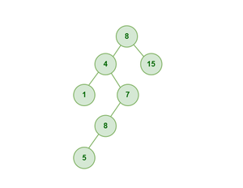
Example of a BST which is NOT AVL

Slide 215
Why AVL Trees?
ensures logarithmic time complexity
maintains sorted structure with balance
faster search, insert, and delete than unbalanced BST

Slide 216
Types of Rotations
single right rotation (LL case)
single left rotation (RR case)
left-right rotation (LR case)
right-left rotation (RL case)

Slide 217
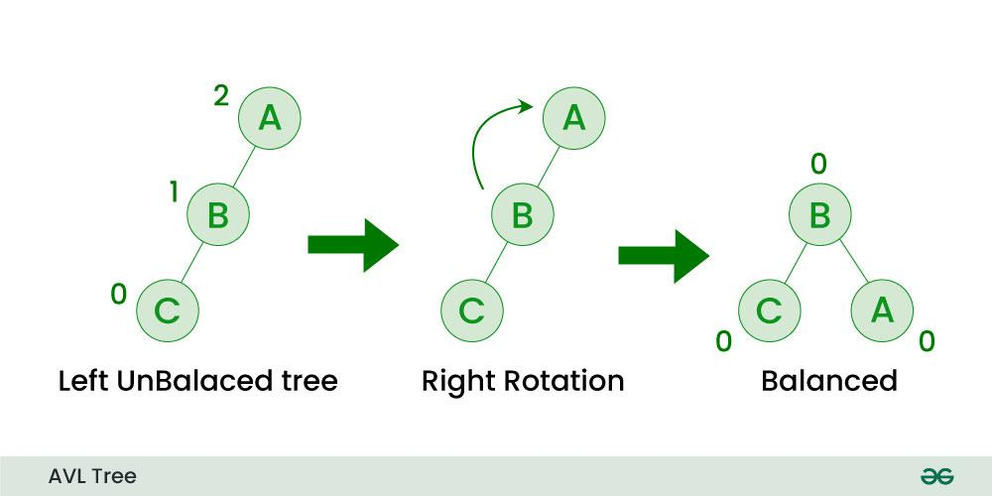
Single Right Rotation (LL case)
If a node is added to the left subtree of the left subtree, the AVL tree may get out of balance, we do a single right rotation.

Slide 218
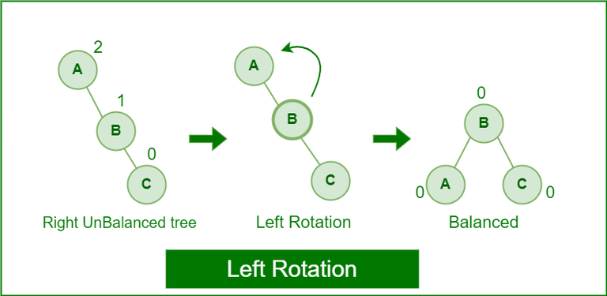
Single Left Rotation (RR case)
When a node is added into the right subtree of the right subtree, if the tree gets out of balance, we do a single left rotation.

Slide 219
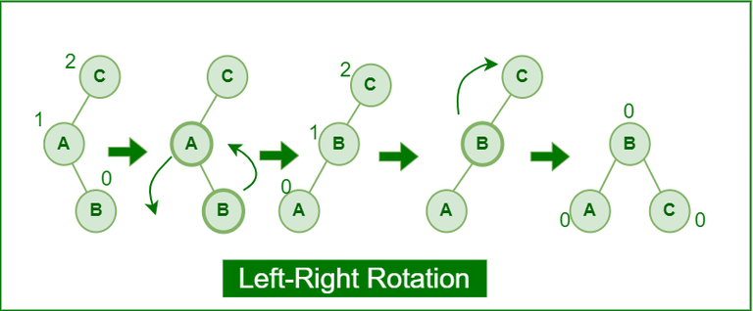
Left-Right Rotation: (LR case)
A left-right rotation is a combination in which first left rotation takes place after that right rotation executes.

Slide 220
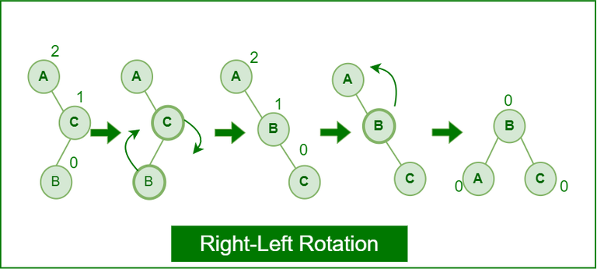
Right-Left Rotation: (RL case)
A right-left rotation is a combination in which first right rotation takes place after that left rotation executes.

Slide 221
Question in SP-14 Terminal Exam

Slide 222
Class Exercise
In a software system, an AVL tree is used to efficiently manage a dataset that needs frequent insertions and lookups. To ensure optimal performance, the AVL tree must remain balanced after each insertion. You are tasked with helping the system maintain its balance by constructing the AVL tree for the following sequence of keys and applying necessary rotations:
Keys to Insert: 12, 5, 30, 18, 7, 25, 40
Tasks: 1. Construct the AVL tree step by step, showing the tree after each key insertion.

